Slide 1



AGGREGATE TRENDS
PRESENTATION 2
Prepared by: Edwin, Ella, Liv & Tatum
Thursday, October 23rd

Slide 2
Our Agenda
01
02
03
04
05

Slide 3
Redirection Analysis

Slide 4

Definitions
Each call can generate multiple legs, redirections help explain how calls move through the system.
Call Start
Call Movement
Call End
Calling Number → number that initiates the call
Direction = TERMINATING → indicates the call is inbound
Correlation ID → groups all call legs of the same session
Called number → initial recipient
Redirecting Number → who last redirected the call
Original Reason→ first trigger for a redirection
Redirect Reason → why subsequent redirection occurs
Related Reason → the trigger that led to a change in call presence
User Type → identifies the endpoint (User, Voicemail, etc.)
Answered → whether the call was answered or not
Report Time → when the call ended
Notes:
Each call record in Webex represents one leg of a larger journey — these columns connect them together.
Call Starts (Who Initiates the Interaction)
Calling Number → number that initiated the call
Direction = TERMINATING → indicates this leg was inbound
Correlation ID → groups all call legs of the same session
These fields establish which call we’re looking at and ensure we can trace all connected records.
Call Movement (How It Gets Redirected)
Called Number → the initial recipient
Original Reason → first trigger for redirection (e.g., NoAnswer, FollowMe)
Redirect Reason → why subsequent redirections occur
Related Reason → secondary system event causing the redirect (e.g., CallQueue, HuntGroup)
Redirecting Number → who last redirected or forwarded the call
These explain the “movement” of the call and let us reconstruct how it bounces across users, queues, and systems.
Call Ends (Where It Lands)
User / User Type → identifies endpoint (e.g., User, Queue, Voicemail)
Answered / Answer Indicator → whether and where it was picked up
Call Outcome / Report Time → how and when the call ended
These fields tell us the end state of the call: who answered, when, and under what conditions.

Slide 5
Definitions
Call Path for Correlation ID ‘9108b891-9c8f-4056-a98c-dea3d0a121a8’ (March 2025).
Called number = 1312296300, Front Desk
Direction = Terminating
Original reason = No Answer
Client initially calls the front desk. No one answers, so the system applies WebX Follow Me logic, which auto-forwards the call based on routing rules.
Redirecting number = 13123411070, Main Line
Redirect reason = Follow Me
User type = Virtual line
Related reason = Call Forward No Answer
User = Ombudsman Intake
Model = Cisco 8841
Answered = TRUE
Call outcome = Success
The redirected call lands on an Ombudsman intake line, which is a real staff endpoint (not voicemail). The Cisco 8841 model indicates a physical Webex desk phone used by the staff member who answered.
Notes:
Let me walk you through one example call to show how the Webex data captures redirection behavior.
This call took place on March 31st, 2025,. It began with the front desk number — 13122296079 — attempting to reach Ombudsman Intake at 13123478300.
In the dataset, this entire interaction is represented by a single Correlation ID, which links every leg of the call — even though the call was redirected multiple times.
The ‘Original reason’ for redirection was logged as NoAnswer, meaning the initial call to Ombudsman Intake wasn’t picked up. When that happens, Webex automatically triggers a rule called ‘Follow Me.’
Follow Me is a configuration that tells the system: if this person doesn’t answer, forward the call to another number or service — in this case, through the main number (13123411070) that acts as the routing hub.
From there, the system redirected the call to Ombudsman’s Cisco 8841 device, which is a physical office phone tied to the VoiceMailRetrieval user type. Since that device also didn’t answer, the call was sent to voicemail, where it was successfully completed.
So in the data, we see multiple rows with the same Correlation ID — one showing the originating leg, one the terminating leg, and one indicating the redirect event.
What this demonstrates is that even when a front-desk or staff member doesn’t answer, the system’s redirection logic ensures the call

Slide 6
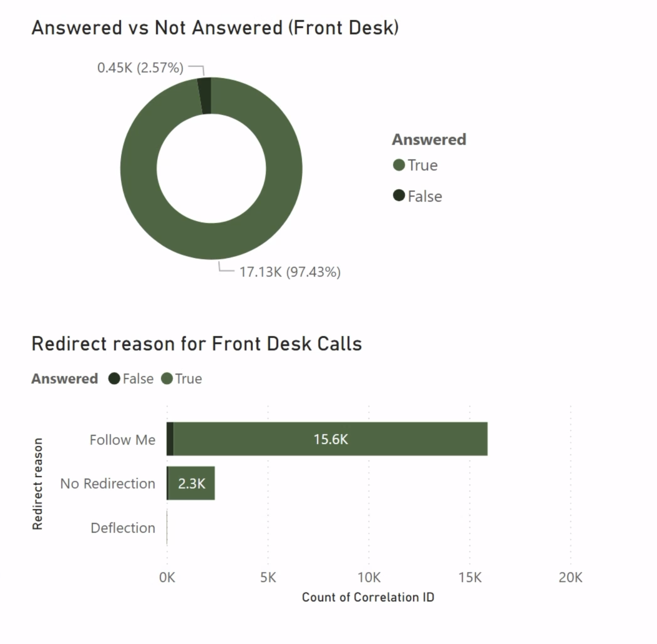
Analysis
Front desk calls are being answered efficiently, with most actively managed through automatic routing.
What We Found:
~ 97% of front desk calls are answered showing strong coverage overall
The dominant redirect reason is “Follow Me”, meaning the calls are automatically routed through Webex’s sequential forwarding logic until answered
Most redirected calls still reach a person, showing that automated routing is working effectively to prevent missed calls for this line
Notes:
Tatum:
This analysis shows that the front desk is performing efficiently — nearly all incoming calls ultimately reach a person, even when they’re redirected. The majority of these calls use Webex’s “Follow Me” feature, which automatically forwards calls through a predefined sequence (for example, from the front desk to another line or team) until someone answers. This automation minimizes missed calls and ensures continuous coverage even when the primary line is busy or unattended.
However, while the system’s routing is effective, it also indicates that much of the workload is being managed through automation rather than direct response. Understanding where these redirected calls go and when peak volumes occur can help optimize staffing patterns, balance workloads, and potentially reduce reliance on Follow Me logic for basic call handling.

Slide 7
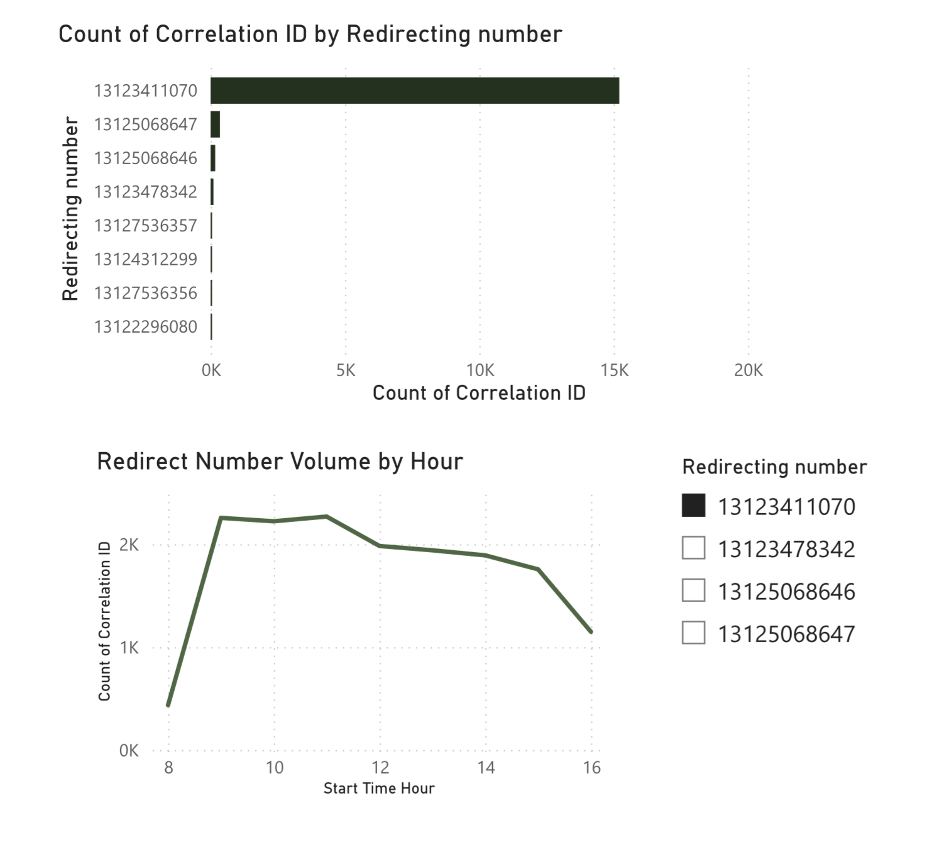
Analysis
Most “Follow Me” redirections from the front desk route through the main number, peaking mid-day and tapering after 4 PM.
What We Found:
15.6k redirected calls route through the main number (13123411070); it seems to act as the system hub
Specialized menus handle smaller volumes, Spanish (13125068647) ~ 347 calls & English (13125068646) ~ 170 calls
Redirect call volumes for the main line from the front desk peak betweenn 9 AM and 2 PM, aligning with business hours
Notes:
These visuals show how the system distributes incoming calls throughout the day and where they are being routed. The main number (13123411070) is not tied to an individual user — it functions as an automated routing hub in the Webex system. Most calls from the front desk are handled through “Follow Me” logic, which is a Webex feature that automatically forwards incoming calls to a series of predefined destinations (such as another line, voicemail, or queue) until the call is answered.
In practice, this means that when a client calls the front desk, the system itself—not a staff member—redirects the call based on routing rules. This ensures coverage even when the front desk is busy or unavailable. The call volume trend shows that activity peaks between 9 AM and 2 PM, reflecting the core hours when most client inquiries occur.
If these patterns align with staff availability, there may be an opportunity to optimize call handling by aligning coverage with these peak hours or by adjusting the routing order to shorten wait times. Alternatively, if these automated redirects are handling overflow, it may indicate that staffing levels during mid-day are insufficient, placing more pressure on the Follow Me system.

Slide 8
Recommendations
XXX
1
Add bilingual auto-menu routing at the front-desk number to reduce unnecessary “Follow Me” transfers. A brief bilingual menu at the front desk entry point would let callers self-select their language immediately, decreasing redirections from this line.
2
3
Notes:
Tatum

Slide 9
Next Steps
Questions & Next Steps
Open Questions
What is the Follow Me routing logic in Webex? Can the configuration be accessed directly or can we only infer it through All Call data?
What are the use cases for callers dialing the front desk directly instead of the main line?
Notes:
Ella
Need to clarify meaning of outbound calls
s a longer call duration a positive or negative?
Why do calls that are redirected for the “Unconditional” or “Deflection” reasons have much longer durations than those redirected for other reasons?
Are calls that are redirected for a certain reason more likely to be redirected again?
Compare to redirection reasons and durations for Outbound calls

Slide 10
Submenu Analysis
Hierarchical Menu Usage Analysis: Power BI Drill-Down Dashboard

Slide 11
Definitions
Defining the Hierarchy and Variables Used
EP (Entry Point)
Flow
Activity
Main menu where a call begins (e.g. Legal Menu, Housing Menu).
A submenu or routing option under an EP.
The final action or step reached within a call (e.g. Language Selection, Queue).
Contact Session ID
Submenu Count
Unknown Values
Unique identifier for each distinct call. Counted each time the ID is within a menu.
Number of submenus navigated during a single call.
Placeholder for missing data. Ensures complete hierarchy display.
Notes:
Liv

Slide 12
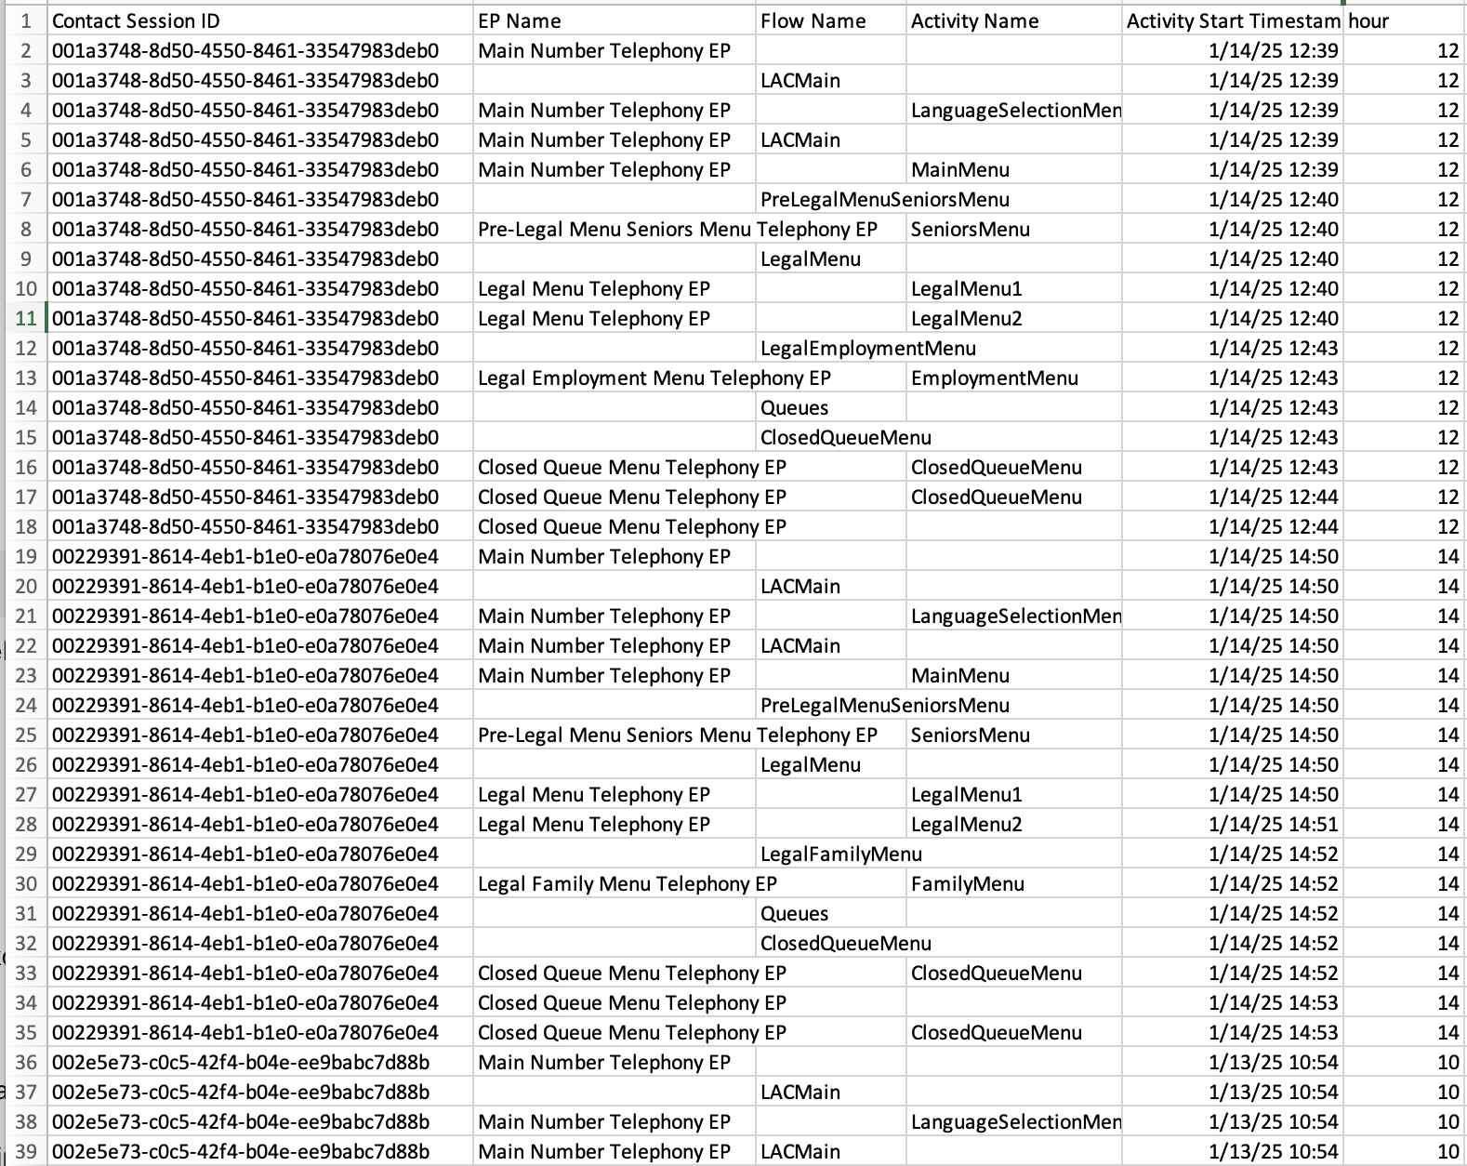
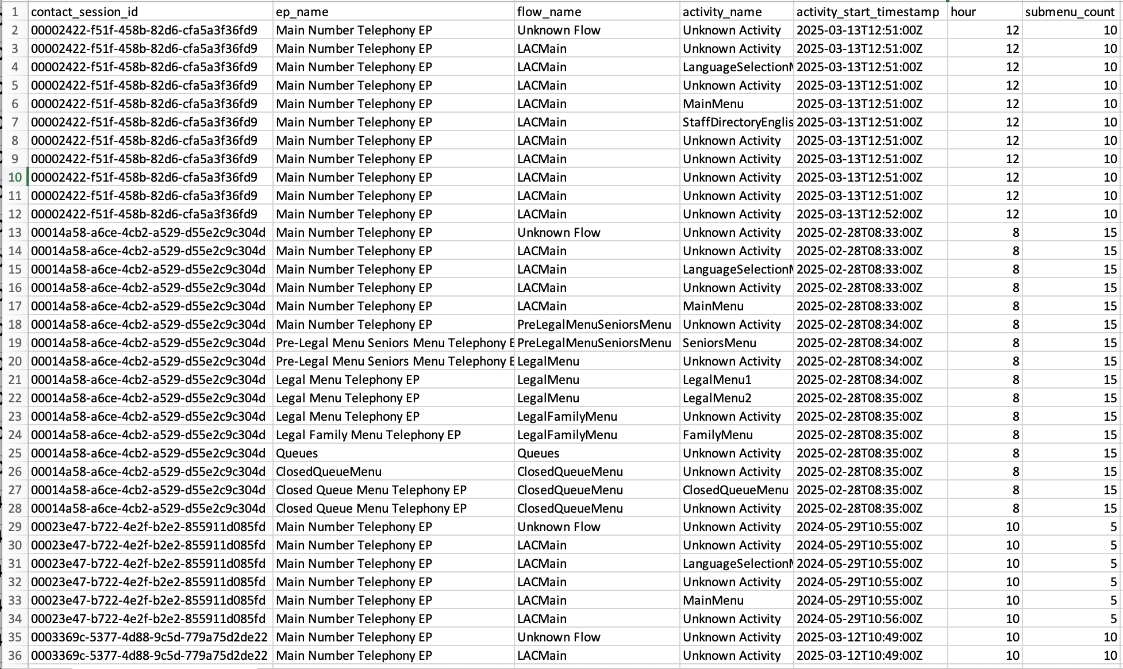
Data Preparation
Preparing the Data for Drill-Down Analysis
What We Did:
Standardized/combined CAR dataset
Created submenu_count variable
Replaced NAs with “Unknown” placeholders
Converted ep_name, flow_name, and activity_name to text
Filled missing EPs and Flows by filling from the row above and grouping by contact_session_id
Notes:
Liv

Slide 13
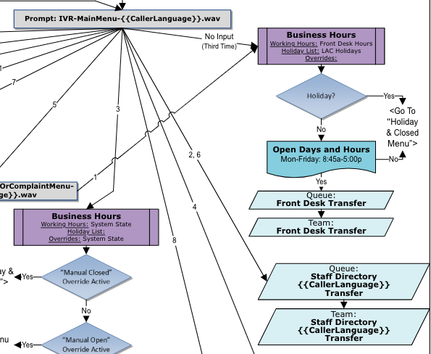
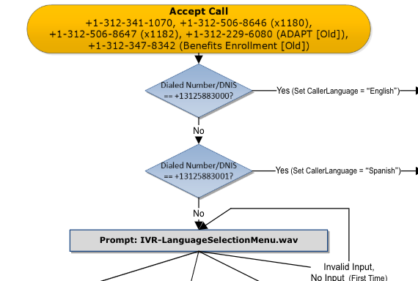
Call Flow
Call Flow Example
Notes:
Ella

Slide 14
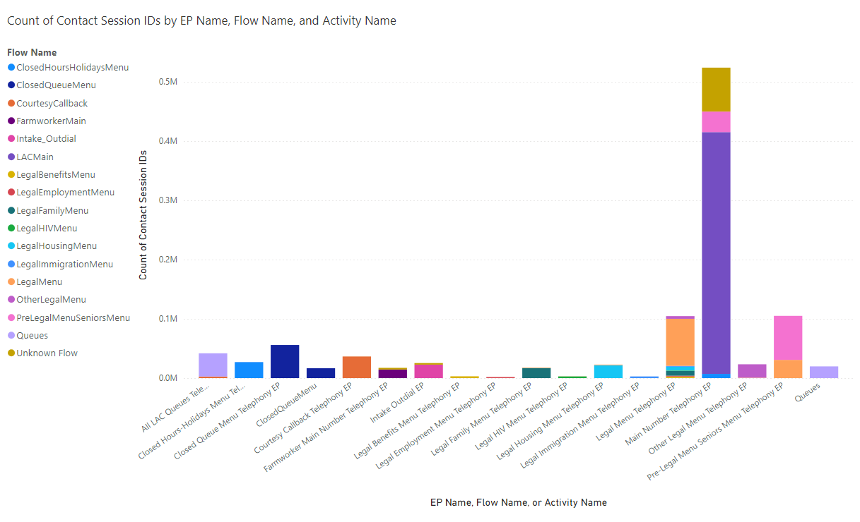
Analysis
Baseline Distribution of Contact Session IDs by EP Name, Colored by Flow Name
What We Found:
The Main EP is visited most frequently; indicates we should prioritize simplifying this EP since it takes extra time to read out all these options
Under the Main Menu, there are 12 Activity Names, which takes 58 seconds to list; separating these activities into 2 groups could improve efficiency
Benefits, Employment, HIV, Immigration EPs are rarely used; could combine these to simplify the system then have them be just flows instead of their own EPs
Notes:
Ella

Slide 15
Recommendations
Recommendations
1
Simplify high-complexity menus
2
Develop Menu Efficiency Metrics
3
Reduce Queue-Related Bottlenecks
Notes:
Ella
2. Does ppl visiting menus a lot of times mean it’s inefficient?
3. Mitigate how many times ppl have to go thru queues

Slide 16
Next Steps
Next Steps & Further Questions
Add interactive filters and KPIs: Include slicers for date, day type, and hours; add cards for total calls and average submenus per EP
Develop efficiency indicators: Calculate average submenu depth per EP or Flow to highlight areas with the most caller confusion or unnecessary steps
Group related menus: Merge similar Eps (e.g. Benefits, Employment, HIV, Immigration) for clearer visualization and comparison
Group related activities: there are 12 options inside of Main Menu → splitting into two groups could improve efficiency
Does the EP → Flow → Activity hierarchy in our cleaned data match LAC’s structure?
Can Cynthia clarify what the Flow Name means?
Would LAC be open to restructuring or merging high-friction menus based on our findings?
Which metrics are most important to LAC between minimizing submenu steps, reducing queue time, or ensuring correct routing on the first try?
Notes:
Liv

Slide 17
Appendix
* Includes additional details and visuals from our preliminary analysis that were not included in the live presentation due to time constraints.

Slide 18
Example Call Journey
Example Call Flow
Notes:
Each call record in Webex represents one leg of a larger journey — these columns connect them together.
Call Starts (Who Initiates the Interaction)
Calling Number → number that initiated the call
Direction = TERMINATING → indicates this leg was inbound
Correlation ID → groups all call legs of the same session
These fields establish which call we’re looking at and ensure we can trace all connected records.
Call Movement (How It Gets Redirected)
Called Number → the initial recipient
Original Reason → first trigger for redirection (e.g., NoAnswer, FollowMe)
Redirect Reason → why subsequent redirections occur
Related Reason → secondary system event causing the redirect (e.g., CallQueue, HuntGroup)
Redirecting Number → who last redirected or forwarded the call
These explain the “movement” of the call and let us reconstruct how it bounces across users, queues, and systems.
Call Ends (Where It Lands)
User / User Type → identifies endpoint (e.g., User, Queue, Voicemail)
Answered / Answer Indicator → whether and where it was picked up
Call Outcome / Report Time → how and when the call ended
These fields tell us the end state of the call: who answered, when, and under what conditions.

Slide 19

Example Call Journey
Data Cleaning (Power BI)
The following was completed in Power BI.

Slide 20
Data Cleaning
Data Cleaning (Python)
The following data cleaning was completed in Python. Code here.

